Slide 1
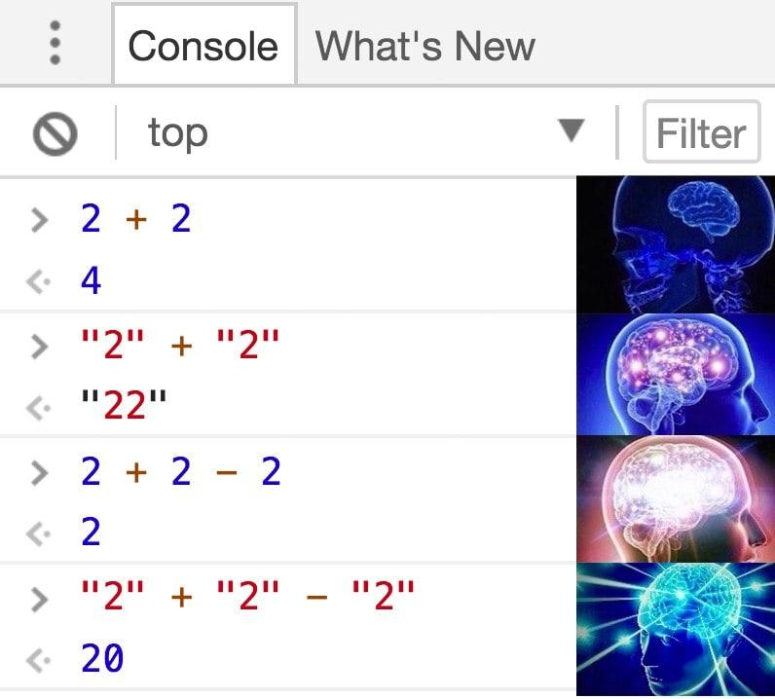
COMP1531 | T09B / H17B Week 1
william.huynh3@unsw.edu.au

Slide 2
Learning objectives
Getting to know your groups + group activity !
Going from C to JavaScript
(printing, variables, arrays, loops, functions)
Quick Admin stuff

Slide 3
🏡Admin: How the course works
Lectures -> Youtube
Help Sessions -> Teams
Group Assignment -> Teams
Labs & Project -> Gitlab
Forum -> Ed
All of the above -> WebCMS

Slide 4
🏡Admin: Attendance & Participation
Tutorial Attendance recorded starting Week 2
Tutorial participation and attendance contributes to your project mark
Low Attendance | Scaling Down
Regular Attendance | No Scaling
Great Attendance + Participation | Scaling Up

Slide 5
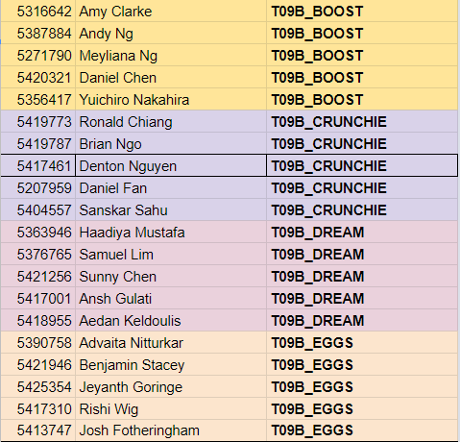
👨‍👩‍👧‍👦T09B Teams
Get to know your Team!
👋 Introduce yourselves !
📲 Exchange contact details + comms
(Discord, Facebook, MS Teams, etc…)
💯 Set your expectations
(HD / D / C / P)
Groups will be finalised Friday night, 16th September

Slide 6
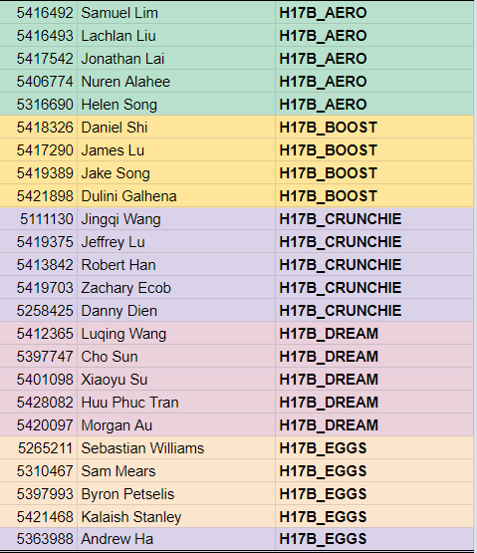
👨‍👩‍👧‍👦H17B Teams
Get to know your Team!
👋 Introduce yourselves !
📲 Exchange contact details + comms
(Discord, Facebook, MS Teams, etc…)
💯 Set your expectations
(HD / D / C / P)
Groups will be finalised Friday night, 16th September

Slide 7
👨‍👩‍👧‍👦Team Problem Solving 🧠
🎥 How many hours of Zoom calls happen in Sydney everyday?
Come up with an exact number

Slide 8
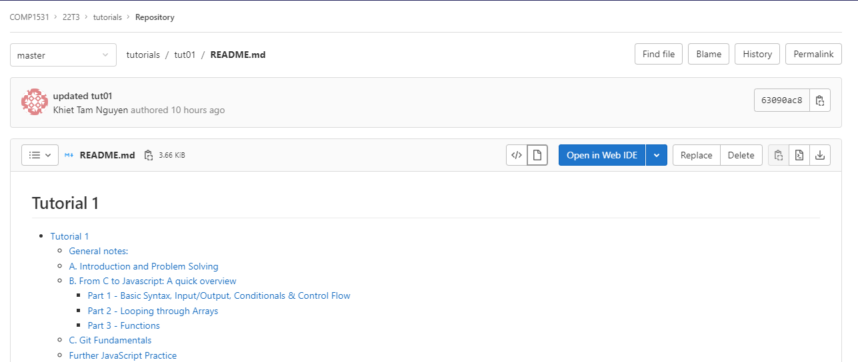
🧠 Tutorial Activities - Getting Started
Click ‘tutorials’ !

Slide 9
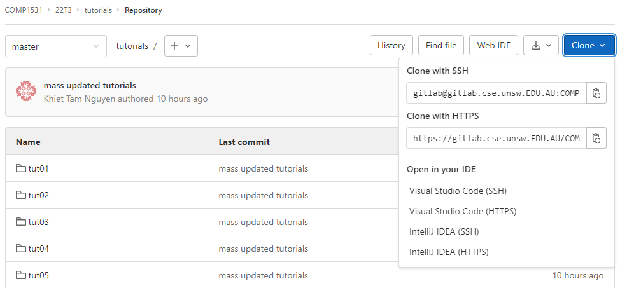
🧠 Tutorial Activities - Getting Started
Click ‘Clone’
2. Under ‘Clone with SSH’,
Click the clipboard icon

Slide 10
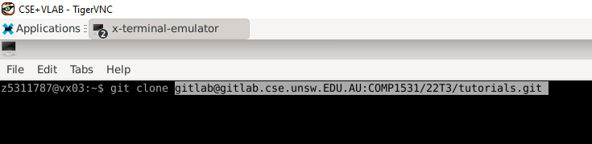
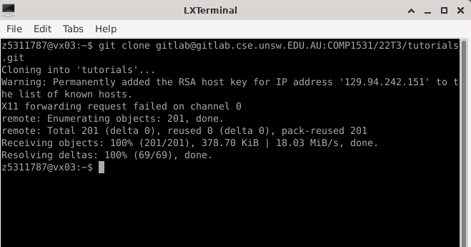
🧠 Tutorial Activities - Getting Started

Slide 11
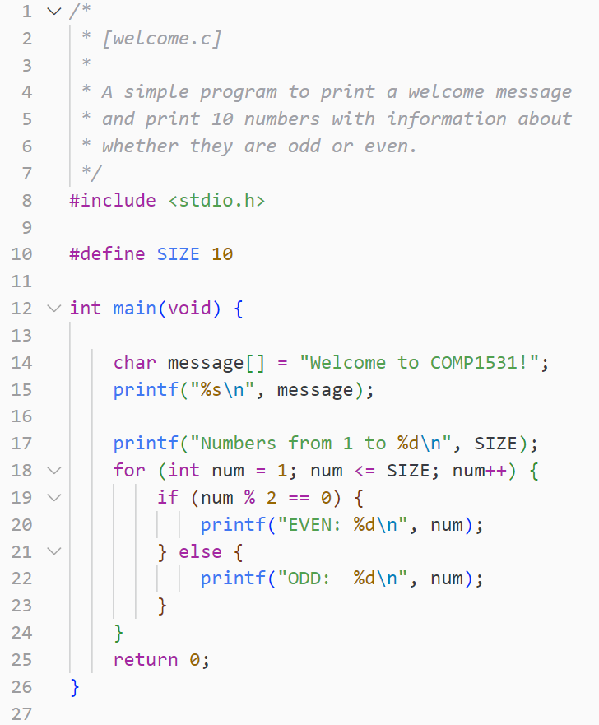
Take a look at welcome.c
How can we convert this C code to JavaScript?
Create a new file called welcome.js
To run the program:
node welcome.js

Slide 12
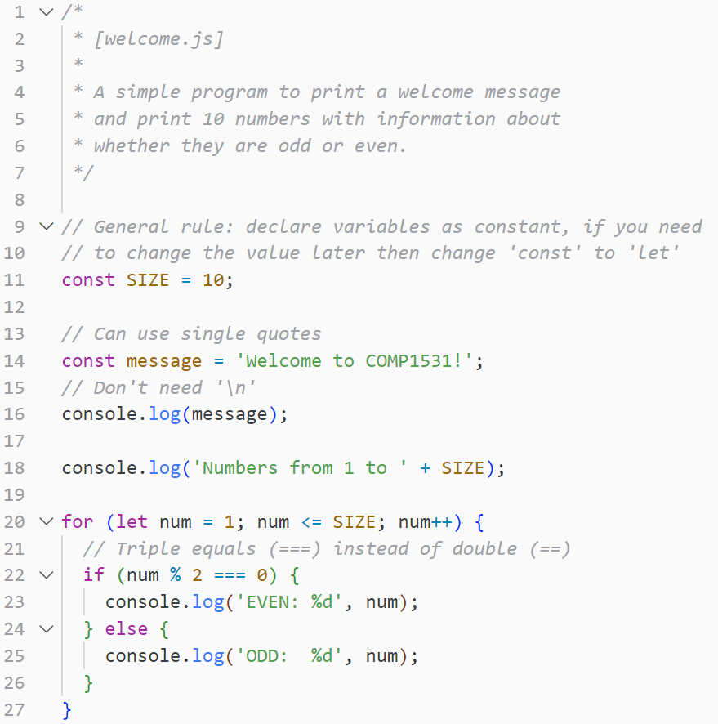

Slide 13
✅ To summarise!
const —> For variables that will not change (immutable)
let —> For variables that will change (mutable)
Always use const unless you need let
var —> Never use this !!!
printf —> Doesn’t automatically add ‘\n’
console.log —> Automatically adds ‘\n’

Slide 14
✍️ Time to write some JavaScript!
Create a new file called shopping.js
Create an array of some grocery items!
Find as many ways of looping through the array as possible!
(Hint: there's at least 3 ways of looping through an array. Try to find them all!)

Slide 15
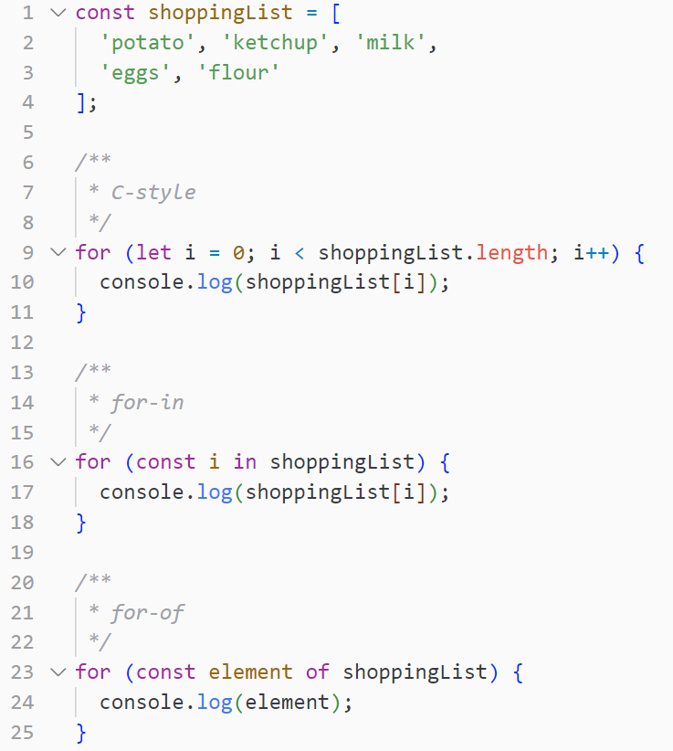
Uses integer based index
Uses integer based index (but less disgusting)
The best way to do loops
For each element in the shoppingList

Slide 16
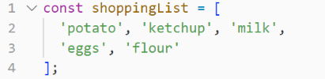
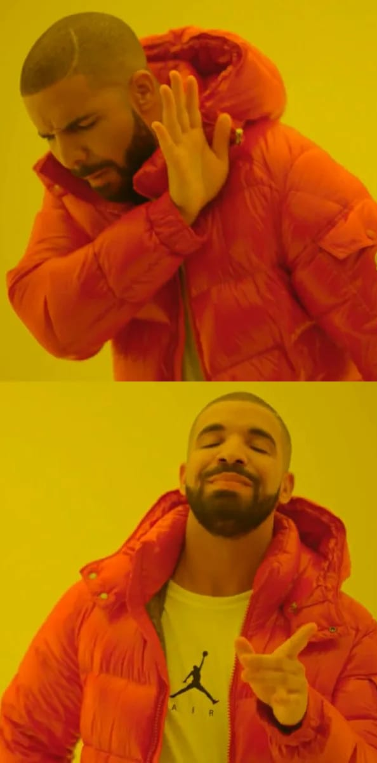
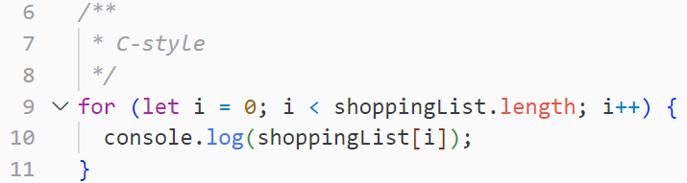
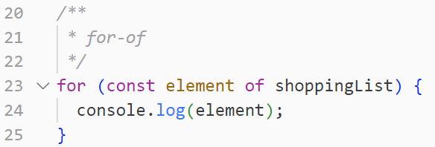
✅ To summarise!
We declare arrays like so:
Always use for…of loops !
(Unless you really need an index loop)

Slide 17
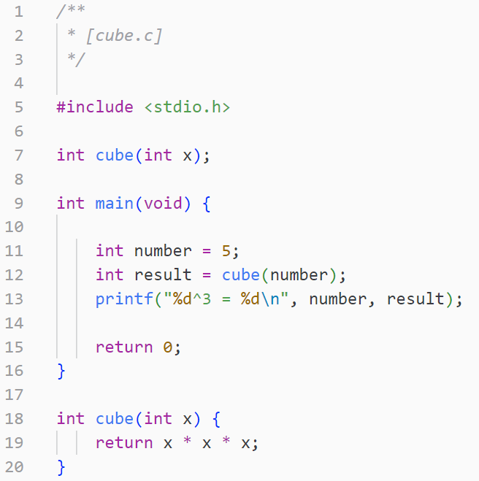
Take a look at cube.c
How can we convert this C code to JavaScript?
Create a new file called cube.js

Slide 18
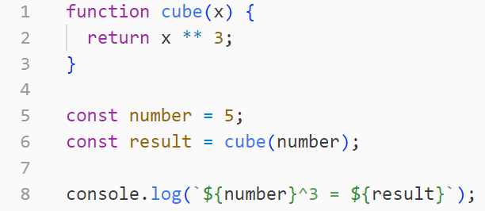
We don’t have function declarations in JavaScript

Slide 19

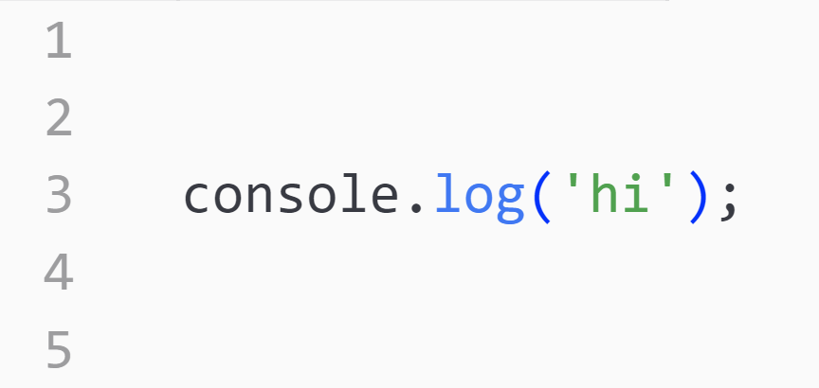
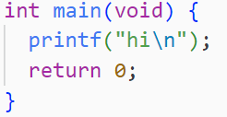
✅ To summarise!
function —> The keyword we use to implement functions in JavaScript
int main (void) —> There are no main functions in JavaScript !

Slide 20
🧪 Labs
Our lab assistant is Cam (please say hi!)
Will be 2 hours time where you can work on the labs
Later in the term, will be used for project check-ins and project help !
Lab attendance is not mandatory, unless there is a project check-in planned for that lab (will be announced)

